Slide 1

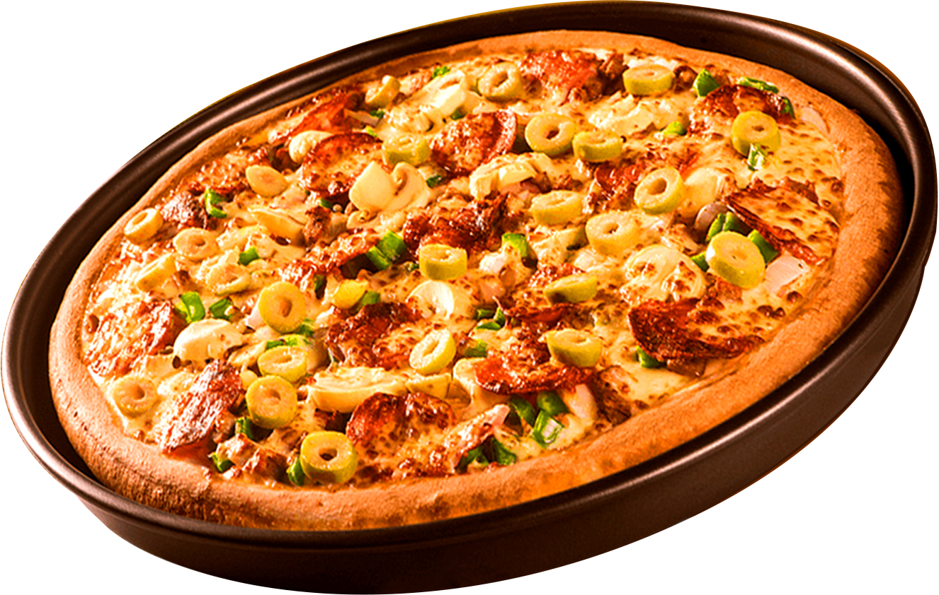
SQL PROJECT DATA ANALYSIS
PIZZA SALES
Turning patterns into powerful decisions.

Slide 2



INTRODUCTION
OBJECTIVE
The project aims to analyze pizza sales data using SQL to measure revenue and order patterns, identify top-performing pizzas, categories, and sizes, and uncover time-based sales trends including peak hours for better operational planning.
SCOPE
“This helps businesses manage stock better, improve marketing, and keep customers happy using data insights.”
TOOLS USED
MySQL Workbench → Used for writing and running SQL queries, joins, and data analysis

Slide 3
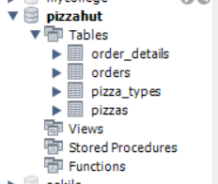
DATASET OVERVIEW
This project is based on a Pizza Sales Dataset.designed to replicate a real-world relational database.
Orders.csv:
Contains the list of customer orders with date and time, which helps in checking sales trends over different days and hours.
Order_Details.csv :
Links each order to the pizzas bought and the quantity, making it possible to find out which pizzas are most popular.
Pizzas.csv :
Includes details like pizza size, type, and price, which I used to calculate revenue and compare performance across sizes.
Pizza_Types.csv :
Describes each pizza by its name, category, and ingredients, which is useful for analyzing category-wise sales .

Slide 4
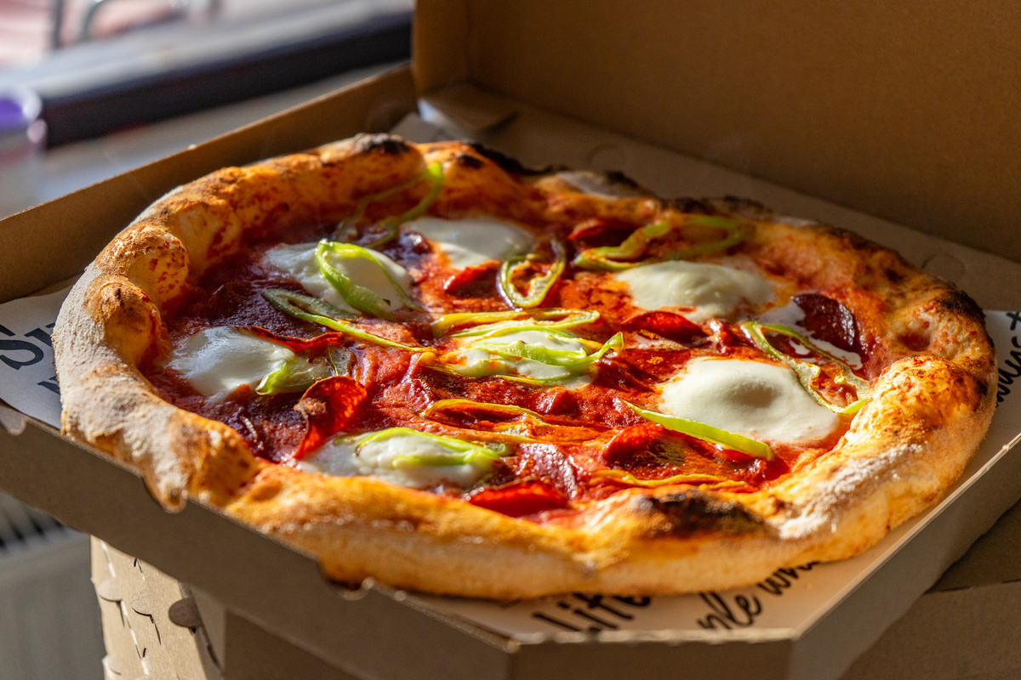
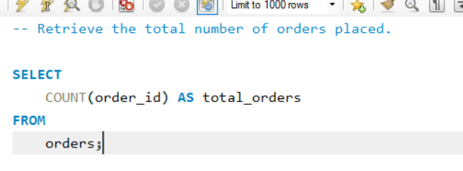
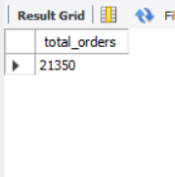

RETRIEVE THE TOTAL NUMBER OF ORDERS PLACED.
SQL QUERY:

Slide 5
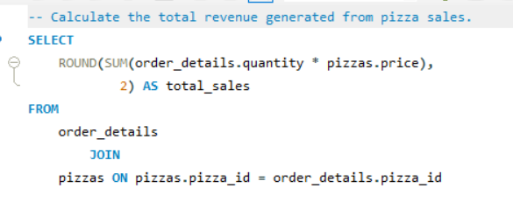
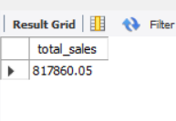
CALCULATE THE TOTAL REVENUE GENERATED FROM PIZZA SALES.
SQL QUERY:

Slide 6
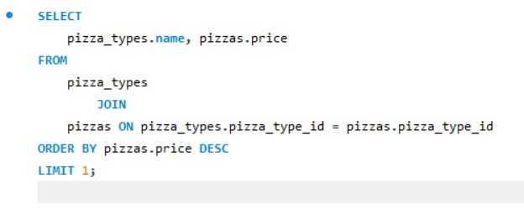
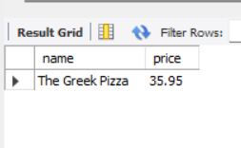
IDENTIFY THE HIGHEST-PRICED PIZZA.
SQL QUERY:

Slide 7
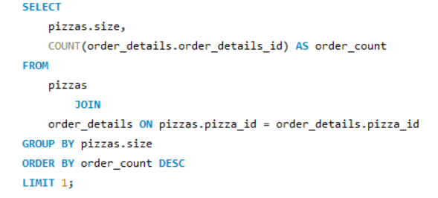
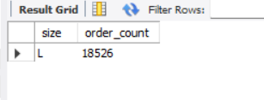
IDENTIFY THE MOST COMMON PIZZA SIZE ORDERED.
SQL QUERY:

Slide 8
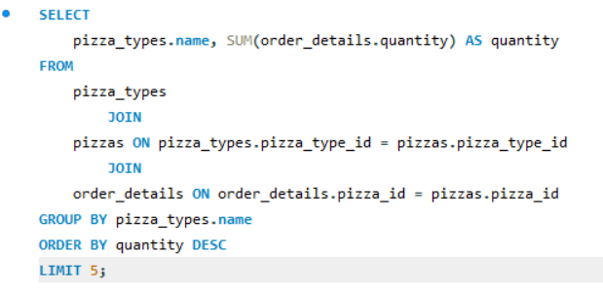
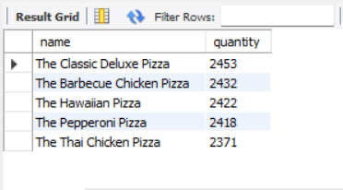
LIST THE TOP 5 MOST ORDERED PIZZA TYPES ALONG WITH THEIR QUANTITIES.
SQL QUERY:

Slide 9
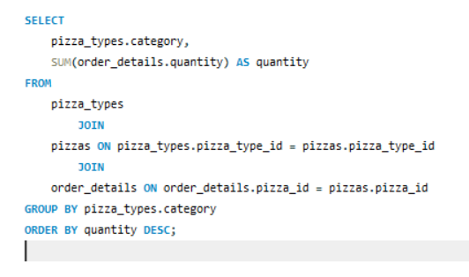
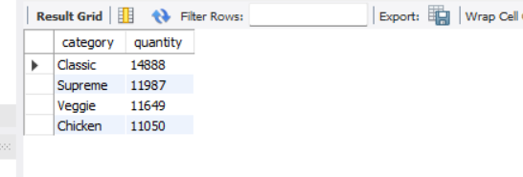
JOIN THE NECESSARY TABLES TO FIND THE TOTAL QUANTITY OF EACH PIZZA CATEGORY ORDERED.
SQL QUERY:

Slide 10
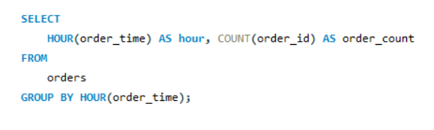
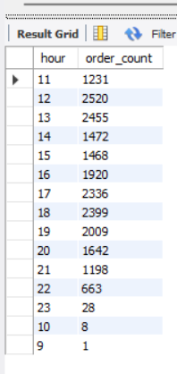
DETERMINE THE DISTRIBUTION OF ORDERS BY HOUR OF THE DAY.
SQL QUERY:

Slide 11
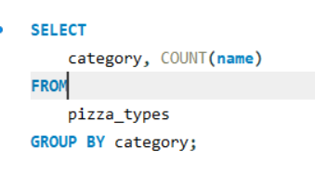
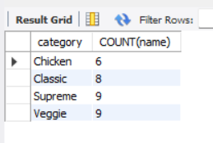
JOIN RELEVANT TABLES TO FIND THE CATEGORY-WISE DISTRIBUTION OF PIZZAS.
SQL QUERY:

Slide 12
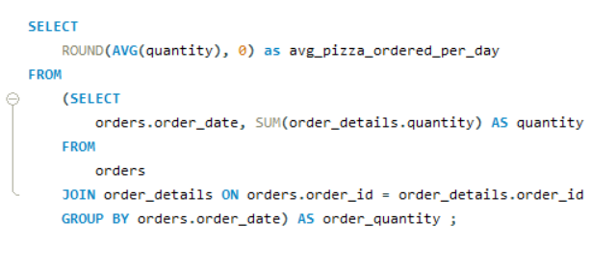
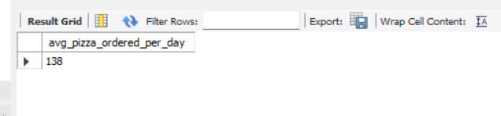
GROUP THE ORDERS BY DATE AND CALCULATE THE AVERAGE NUMBER OF PIZZAS ORDERED PER DAY.
SQL QUERY:

Slide 13
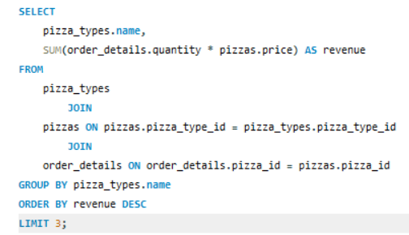
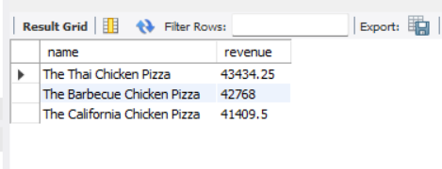
DETERMINE THE TOP 3 MOST ORDERED PIZZA TYPES BASED ON REVENUE.
SQL QUERY:

Slide 14
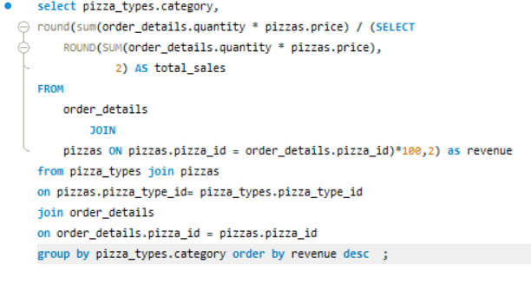
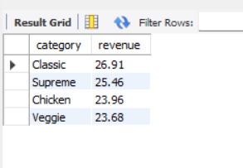
CALCULATE THE PERCENTAGE CONTRIBUTION OF EACH PIZZA TYPE TO TOTAL REVENUE.
SQL QUERY:

Slide 15
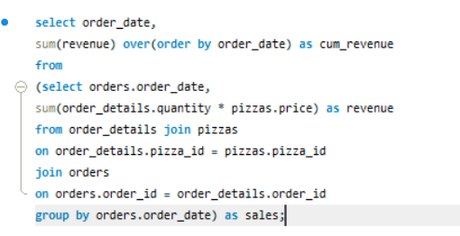
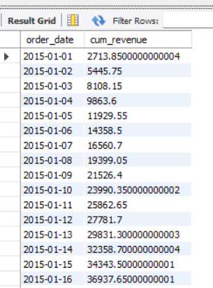
ANALYZE THE CUMULATIVE REVENUE GENERATED OVER TIME.
SQL QUERY:

Slide 16
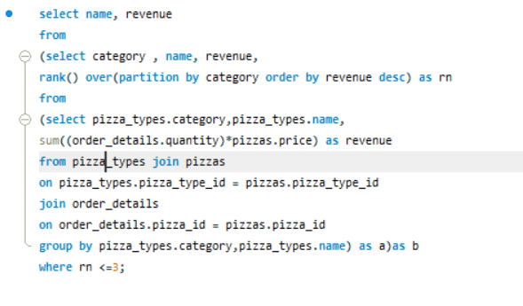
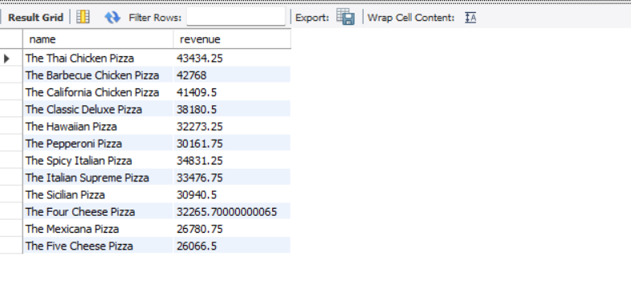
DETERMINE THE TOP 3 MOST ORDERED PIZZA TYPES BASED ON REVENUE FOR EACH PIZZA CATEGORY.
SQL QUERY:

